Slide 1
Intelligent Agents
Russell and Norvig:
Chapter 2

Slide 2
Intelligent Agent
percepts
sensors
environment
?
agent
actuators
actions
Definition: An intelligent agent perceives its environment via sensors and acts rationally upon that environment with its actuators.

Slide 3
e.g., Humans
Sensors:
Eyes (vision), ears (hearing), skin (touch), tongue (gustation), nose (olfaction), neuromuscular system (proprioception)
Percepts:
At the lowest level – electrical signals
After preprocessing – objects in the visual field (location, textures, colors, …), auditory streams (pitch, loudness, direction), …
Actuators: limbs, digits, eyes, tongue, …
Actions: lift a finger, turn left, walk, run, carry an object, …

Slide 4
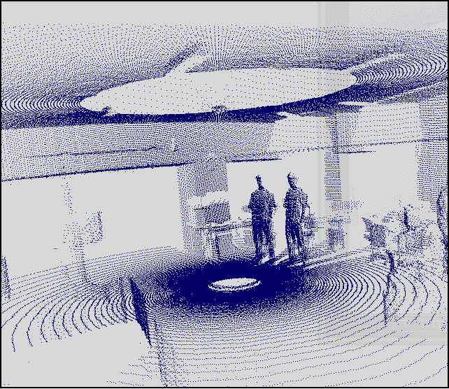
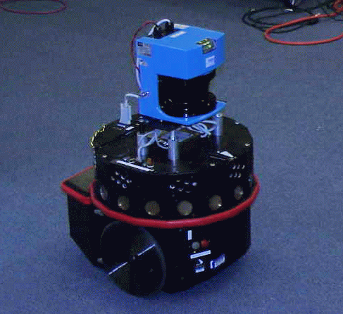
Notion of an Artificial Agent
sensors
?
environment
agent
actuators
laser range
finder
sonars
touch sensors

Slide 5
Vacuum Cleaner World
Percepts: location and contents, e.g. [A, Dirty]
Actions: Left, Right, Suck, NoOp

Slide 6
Vacuum Agent Function
Percept Sequence | Action
[A, Clean] | Right
[A, Dirty] | Suck
[B, Clean] | Left
[B, Dirty] | Suck
[A, Clean], [A, Clean] | Right
[A, Clean], [A, Dirty] | Suck
…

Slide 7
Rational Agent
What is rational depends on:
Performance measure - The performance measure that defines the criterion of success
Environment - The agents prior knowledge of the environment
Actuators - The actions that the agent can perform
Sensors - The agent’s percept sequence to date
We’ll call all this the Task Environment (PEAS)

Slide 8
Vacuum Agent PEAS
Performance Measure: minimize energy consumption, maximize dirt pick up. Making this precise: one point for each clean square over lifetime of 1000 steps.
Environment: two squares, dirt distribution unknown, assume actions are deterministic and environment is static (clean squares stay clean)
Actuators: Left, Right, Suck, NoOp
Sensors: agent can perceive its location and whether location is dirty

Slide 9
Automated taxi driving system
Performance Measure: Maintain safety, reach destination, maximize profits (fuel, tire wear), obey laws, provide passenger comfort, …
Environment: U.S. urban streets, freeways, traffic, pedestrians, weather, customers, …
Actuators: Steer, accelerate, brake, horn, speak/display, …
Sensors: Video, sonar, speedometer, odometer, engine sensors, keyboard input, microphone, GPS, …

Slide 10
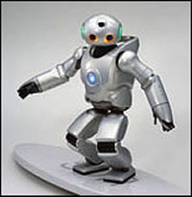
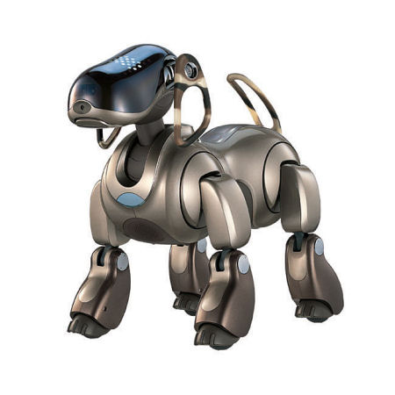
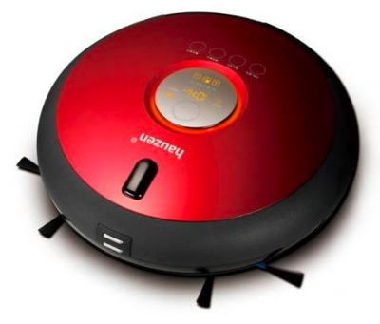
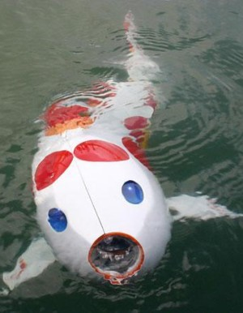
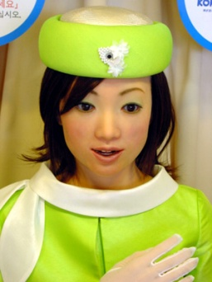
Assignment#1
You have a week:
Form groups of 1 person
Be a membership of this course in Facebook
Group = “AI-2025” or
We invite you to the group
Define PEAS for one of these…
SONY Dancing Robot
AIBO
Autonomous Vacuum Cleaner
Fish Robot
Robot Receptionist
… Etc

Slide 11
Autonomy
A system is autonomous to the extent that its own behavior is determined by its own experience.
Therefore, a system is not autonomous if it is guided by its designer according to a priori decisions.
To survive, agents must have:
Enough built-in knowledge to survive.
The ability to learn.

Slide 12
Properties of Environments
Fully Observable/Partially Observable
If an agent’s sensors give it access to the complete state of the environment needed to choose an action, the environment is fully observable.
Such environments are convenient, since the agent is freed from the task of keeping track of the changes in the environment.
Deterministic/Stochastic
An environment is deterministic if the next state of the environment is completely determined by the current state of the environment and the action of the agent.
In a fully observable and deterministic environment, the agent need not deal with uncertainty.

Slide 13
Properties of Environments
Static/Dynamic.
A static environment does not change while the agent is thinking.
The passage of time as an agent deliberates is irrelevant.
The agent doesn’t need to observe the world during deliberation.
Discrete/Continuous.
If the number of distinct percepts and actions is limited, the environment is discrete, otherwise it is continuous.

Slide 14
Environment Characteristics
 | Fully Observable | Deterministic | Static | Discrete
Solitaire | No | Yes | Yes | Yes
Backgammon | Yes | No | Yes | Yes
Taxi driving | No | No | No | No
Internet shopping | No | No | No | No
Medical diagnosis | No | No | No | No
→ Lots of real-world domains fall into the hardest case!

Slide 15
Some agent types
(0) Table-driven agents
use a percept sequence/action table in memory to find the next action. They are implemented by a (large) lookup table.
(1) Simple reflex agents
are based on condition-action rules, implemented with an appropriate production system. They are stateless devices which do not have memory of past world states.
(2) Model-based reflex agents
have internal state, which is used to keep track of past states of the world.
(3) Goal-based agents
are agents that, in addition to state information, have goal information that describes desirable situations. Agents of this kind take future events into consideration.
(4) Utility-based agents
base their decisions on classic axiomatic utility theory in order to act rationally.

Slide 16
(0) Table-driven agents
Table lookup of percept-action pairs mapping from every possible perceived state to the optimal action for that state
Problems
Too big to generate and to store (Chess has about 10¹²⁰ states, for example)
No knowledge of non-perceptual parts of the current state
Not adaptive to changes in the environment; requires entire table to be updated if changes occur
Looping: Can’t make actions conditional on previous actions/states

Slide 17
(1) Simple reflex agents
Rule-based reasoning to map from percepts to optimal action; each rule handles a collection of perceived states
Problems
Still usually too big to generate and to store
Still no knowledge of non-perceptual parts of state
Still not adaptive to changes in the environment; requires collection of rules to be updated if changes occur
Still can’t make actions conditional on previous state

Slide 18
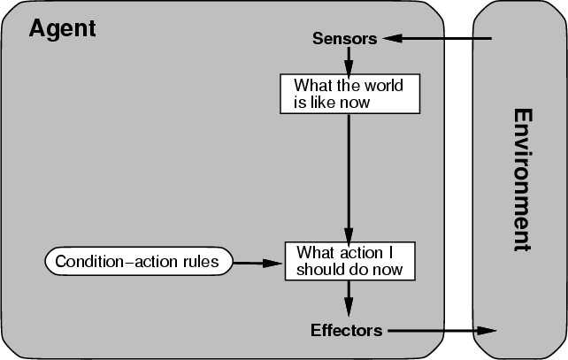
(1) Simple reflex agent architecture

Slide 19
Simple Vacuum Reflex Agent
function Vacuum-Agent([location,status])
returns Action
if status = Dirty then return Suck
else if location = A then return Right
else if location = B then return Left

Slide 20
(2) Model-based reflex agents
Encode “internal state” of the world to remember the past as contained in earlier percepts.
Needed because sensors do not usually give the entire state of the world at each input, so perception of the environment is captured over time. “State” is used to encode different "world states" that generate the same immediate percept.

Slide 21
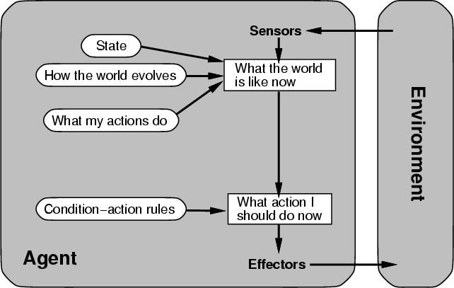
(2)Model-based agent architecture

Slide 22
(3) Goal-based agents
Choose actions so as to achieve a (given or computed) goal.
A goal is a description of a desirable situation.
Keeping track of the current state is often not enough − need to add goals to decide which situations are good
Deliberative instead of reactive.
May have to consider long sequences of possible actions before deciding if goal is achieved – involves consideration of the future, “what will happen if I do...?”

Slide 23
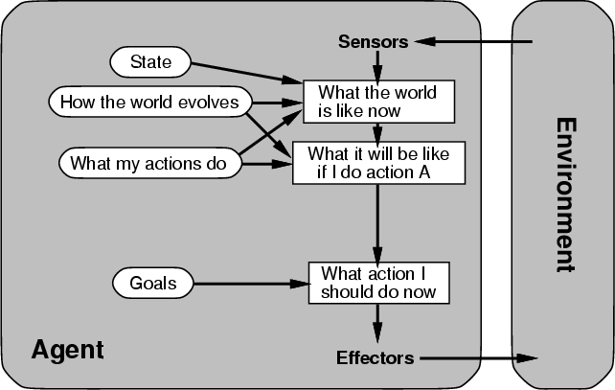
(3) Architecture for goal-based agent

Slide 24
(4) Utility-based agents
When there are multiple possible alternatives, how to decide which one is best?
A goal specifies a crude distinction between a happy and unhappy state, but often need a more general performance measure that describes “degree of happiness.”
Utility function U: State → Reals indicating a measure of success or happiness when at a given state.
Allows decisions comparing choice between conflicting goals, and choice between likelihood of success and importance of goal (if achievement is uncertain).

Slide 25
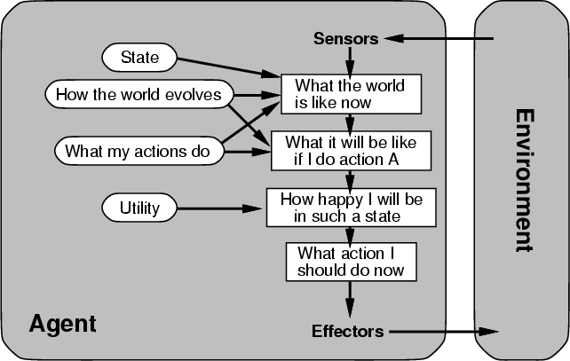
(4) Architecture for a complete utility-based agent

Slide 26
Summary: Agents
An agent perceives and acts in an environment, has an architecture, and is implemented by an agent program.
Task environment – PEAS (Performance, Environment, Actuators, Sensors)
An ideal agent always chooses the action which maximizes its expected performance, given its percept sequence so far.
An autonomous learning agent uses its own experience rather than built-in knowledge of the environment by the designer.
An agent program maps from percept to action and updates internal state.
Reflex agents respond immediately to percepts.
Goal-based agents act in order to achieve their goal(s).
Utility-based agents maximize their own utility function.
Representing knowledge is important for successful agent design.
The most challenging environments are not fully observable, nondeterministic, dynamic, and continuous

